Slide 1
Intro to AI in Medicine
Lec 17: When to use AI/Final Lecture

Slide 2
Last Time
Interactive case study
Practiced talking to people with different backgrounds, who were experts in different areas and synthesizing recommendations
Learned that stakeholders have variable motivations
Any thoughts 2 days later?

Slide 3
This time
Last lecture
Discussing intuition on AI and when to use it – and when not to

Slide 4
Final Project
Due Sunday 11:59 PM to me over email
Will stay today to answer questions
No other office hours but will be reachable via email, text, dm
If you will have <15 classes attended by next Monday, passing is higher for you than 70%

Slide 5
Question
What are some ways this semester we’ve seen AI fail to achieve it’s intended goal?

Slide 6
AI Failure Modes
Low awareness of clinical consequences
Data that does not reflect reality
Fitting to noise, not signal
Imprecision in a well-defined workflow (use what instead?)
Goals of AI and humans misaligned
Resource intensive
Notes:
Bad data can cause inaccuracies or propagate bias
Data: Could be left out a variable, data
Overfit: model too big

Slide 7
General Problem Statement
Technical Problem Statement
Data | Loss
Network | Training
Hallucinations
Bias
Underfit Drift
Alignment
Overfit
PHI protection
Financial/Environmental costs
Notes:
We learned all these things for a reason – now we understand how they can cause issues at a macro scale

Slide 8
When is AI Feasible - Intuition
Short answer – if you can solve data and loss, the rest is easy
Questions to ask yourself:
Can we come up with a mathematical definition of success?
Are there tons of examples of what success and failure are?
Can we do these quickly?
This often happens when tasks are digitizable
When is an algorithm better:
You need perfection
You can create a “recipe” of how to get from start to finish
Notes:
Robotics (washing the dishes) – poorly digitizable
Next character prediction – very digitizable

Slide 9
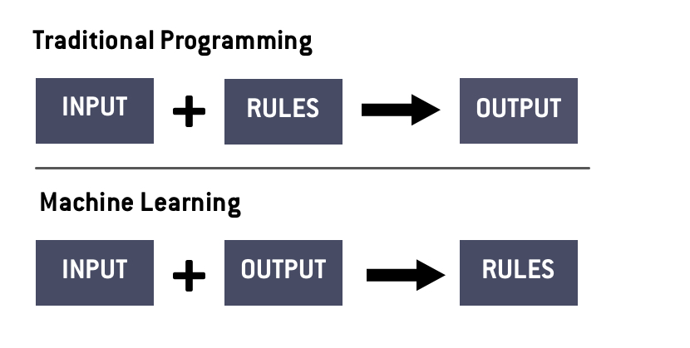

Slide 10
In More Human Terms…
If a human had:
infinite attention span
Infinite time
And their job was:
Give things a score
Place into one of many classes
Then an AI can probably be trained to do it.

Slide 11
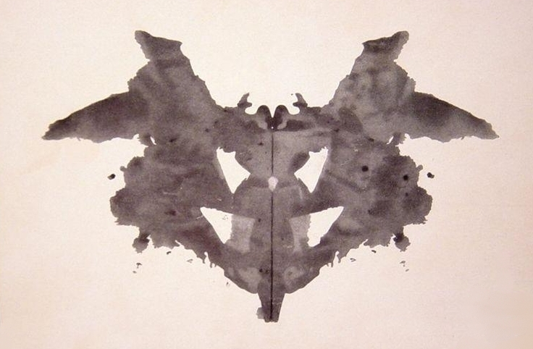
In More Human Terms…
Examples:
Rorschach blots
Pictures of trees
Notes:
Blots: Imagine you were in a room and someone slid under the door pictures of rorshach blots. You put them in ½ slots. If you miss, you get an electric shock, if you get right, you get food. Over time you learn that darker pictures are more likely to get you the reward. Over more time you learn that darkness in the bottom left gets a reward
Same as pneumonia detection
Trees: Imagine if someone slid pictures of trees under the door. You had to return an essay explaining how tree microbiology works. No chance, no matter how much time you have.

Slide 12
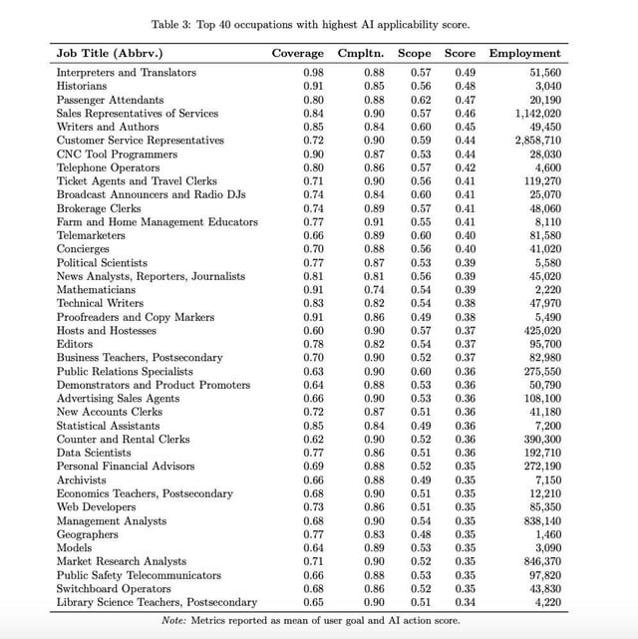
The Future of AI – Who will be replaced?
Low skill, white collar work
High skill, white collar work
Low skill, blue collar work
High skill, blue collar work
AI rate limiters are data and digitization (corollary to loss)
Typically, data moves faster than digitization
https://arxiv.org/pdf/2507.07935
Notes:
Spreadsheet shuffling, translation, librarian
Computer programmer
Factory worker
Surgeon
How fast can you calculate loss from one datapoint

Slide 13
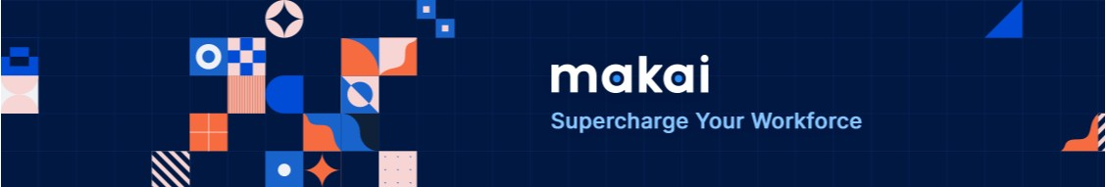
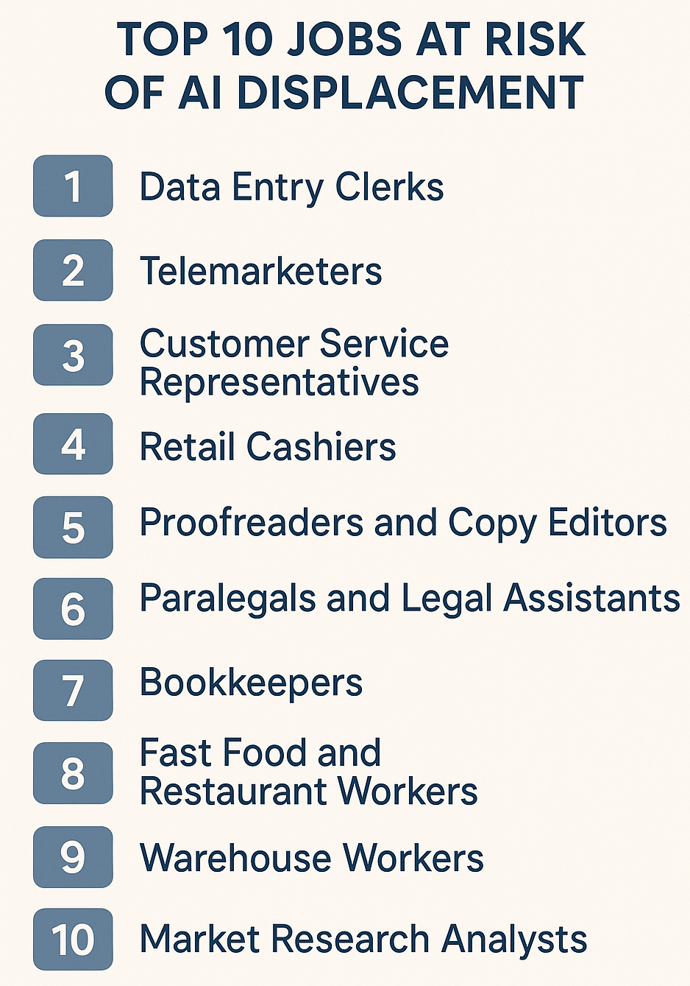
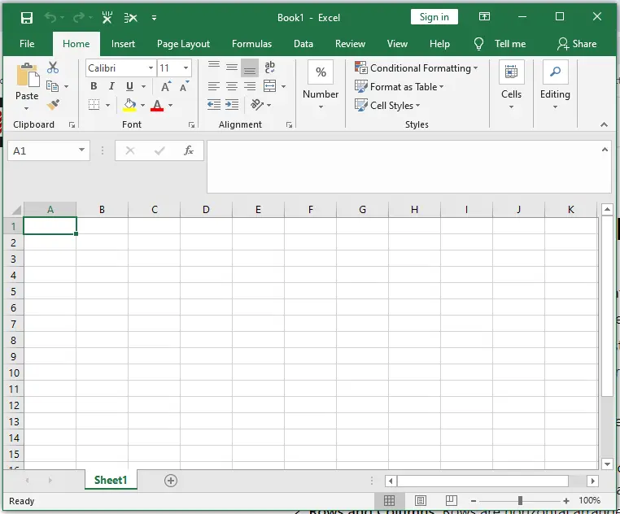

Slide 14
Directions for AI
Network Architectures
Domain specific AI applications
AI Domain transfer
Alignment
Human AI interaction
I hope you all will contribute to these in some way!

Slide 15
Course Feedback
What lectures were most memorable? (not including last one)
What should have been covered in more depth? What can be skipped?
Biggest takeaway from the course?
What kind of people would benefit from this class? (career, personal interest)
What kind of assignments make sense if this class is a regular college course?
Any other comments?

Slide 16
Thanks!

